Slide 1
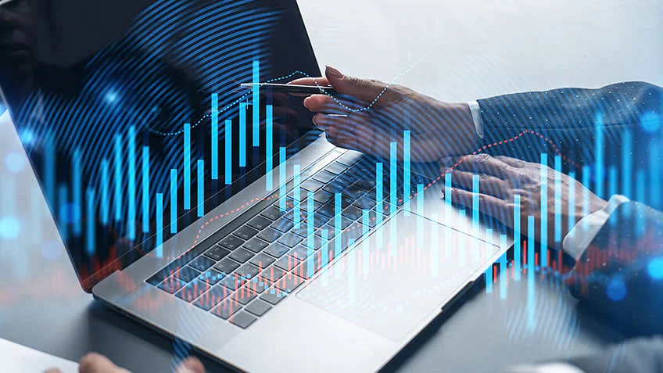
NEXT HIKES
IT SOLUTIONS
PROJECT – 1
On Data Acquisition Data Wrangling Using Pandas and NumPy
Presentation By
Jovita Tigga
Start Date : November 28, 2023
Submitted On : December 23, 2023

Slide 2
Table of Content
Problem Statement
Overview on Python Libraries.
Data acquisition
Data wrangling
Data Visualization

Slide 3
OverVIEW OF MY Project
Type of project: Data Acquisition & Data Wrangling Dataset selection: Used the datasets provided by the Mentor. Discarded fields: Unnamed: 0 Features: ‘season’, ’ yr’, ’ mnth’, ’ hr’, ’ holiday’, ’ weekday’, ’ workingday’, ’ weathersit’, ’ temp’, ’ hum’, ’windspeed’ Label : ‘cnt’ Libraries used : Pandas, Numpy, Matplotlib, Seaborn.
. Import the data. Analyze the data. . Drop the irrelevant fields. . Understand the data. . Preprocess the data for modelling (Data Cleaning). . Work on central tendency. . Worked on missing values and outliers.
. Check the skewness and correlation of the data. . Analyze the data through visualizations using Boxplot.
I have used the ‘cnt’ as label as the figures of rentals changes depending on the features given in the dataset.

Slide 4
TASK 1 - Data Acquisition and Data Wrangling on dataset 1 Task 2: Data Acquisition and Wrangling on Dataset 3
OBJECTIVE – TASK 1
OBJECTIVE – TASK
Acquiring data from Excel.
Reading Data; Data manipulation.
Merge datasets
Identify unique values
Drop unnecessary columns
Check the dimensions of the dataset
Check the datatype of the dataset
Check datatype summary
Treat missing values
Central tendency
Concatenate Task 1 merged data with Dataset_3.
Work on missing values and outliers.
Skewness and correlation of the data.

Slide 5
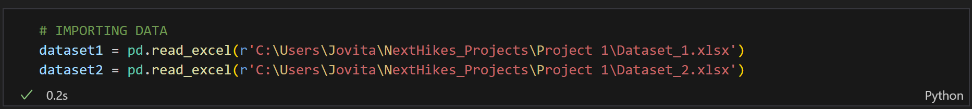
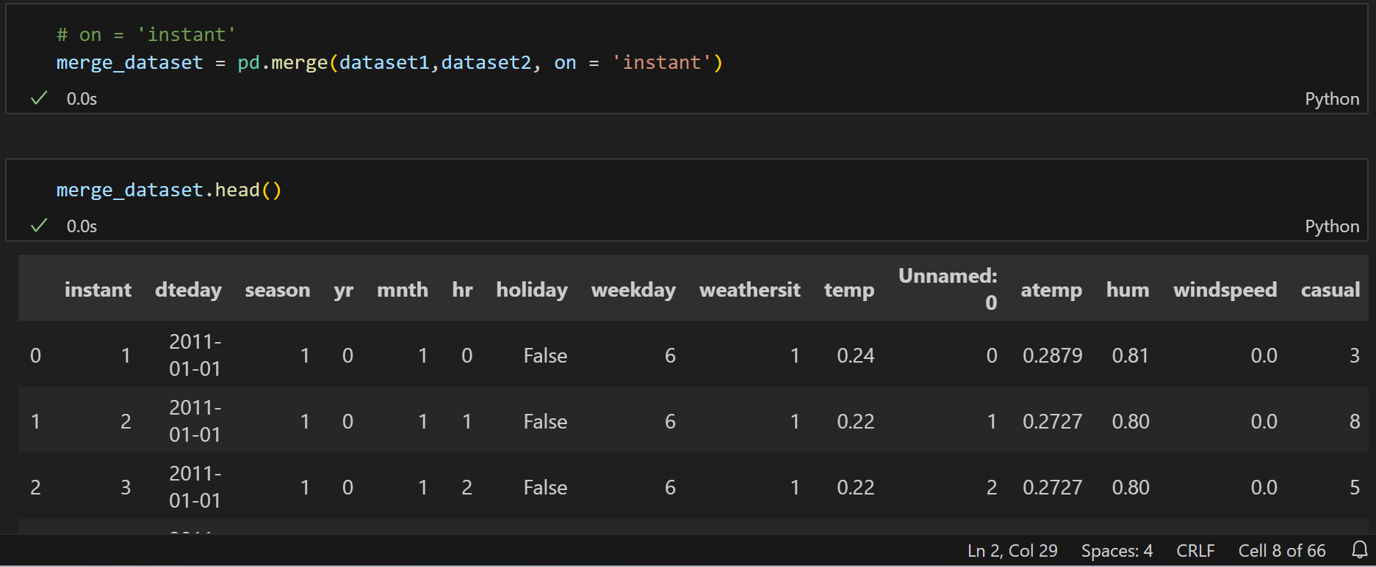
Imported Data from the given path.
Merge datasets - Combing 2 datasets using a common column

Slide 6
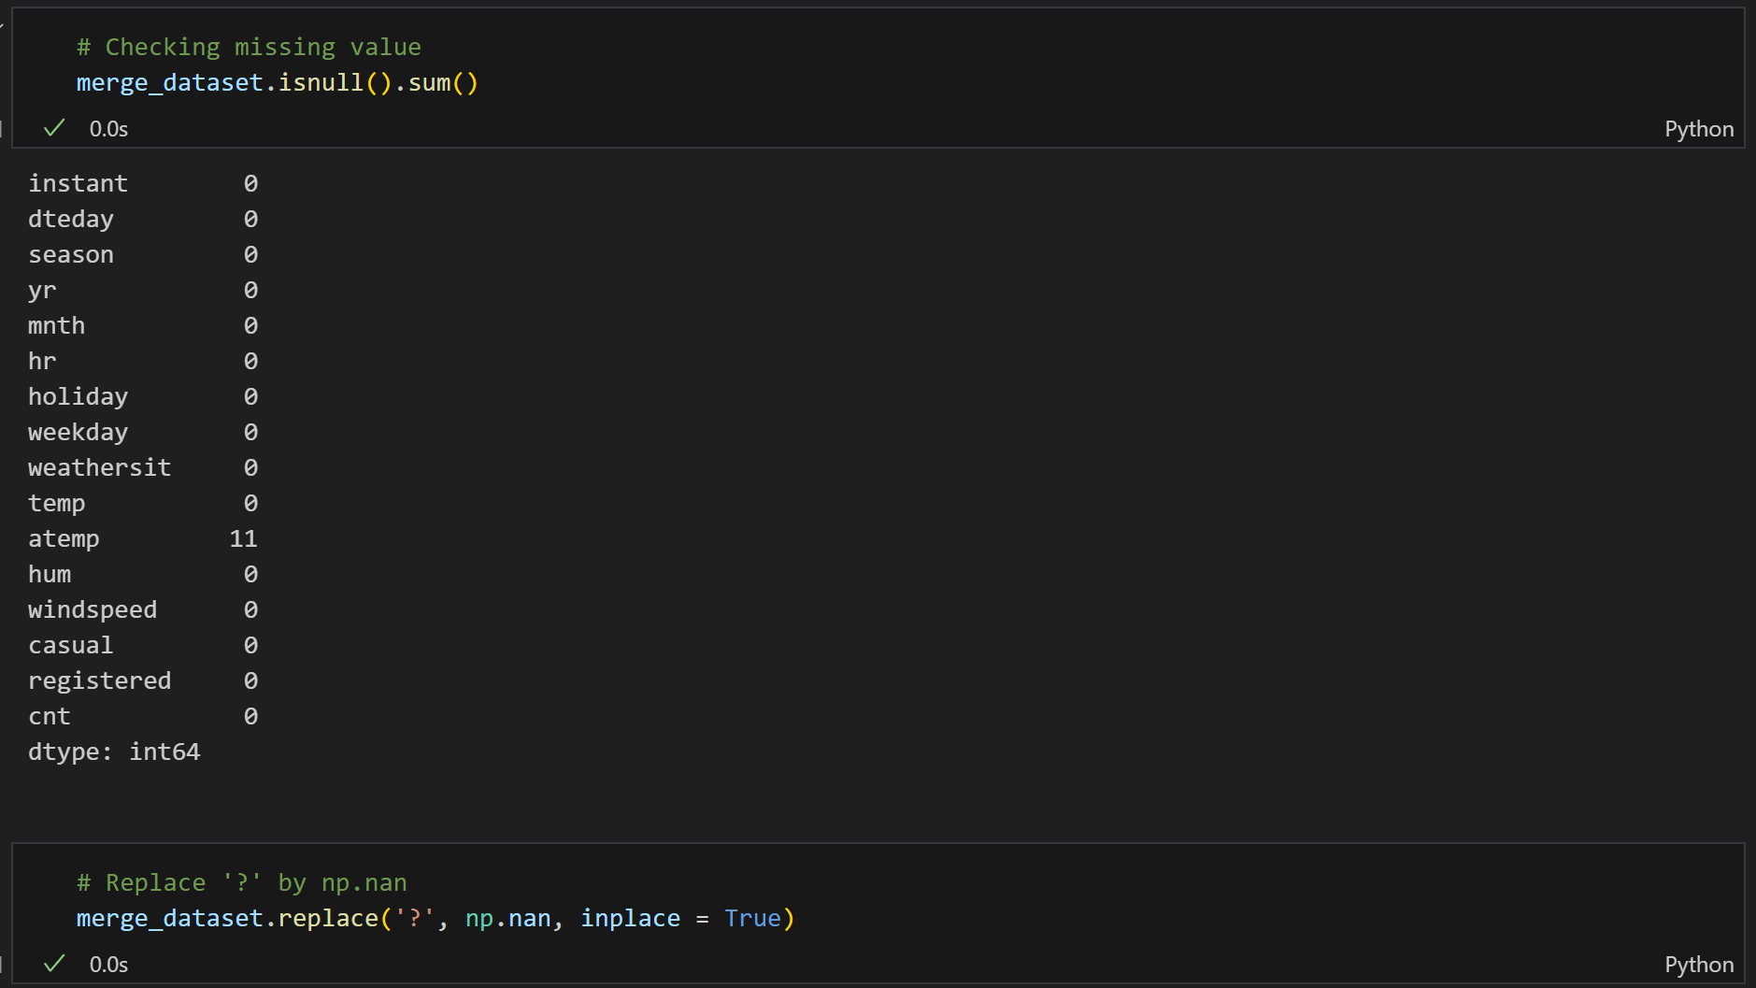
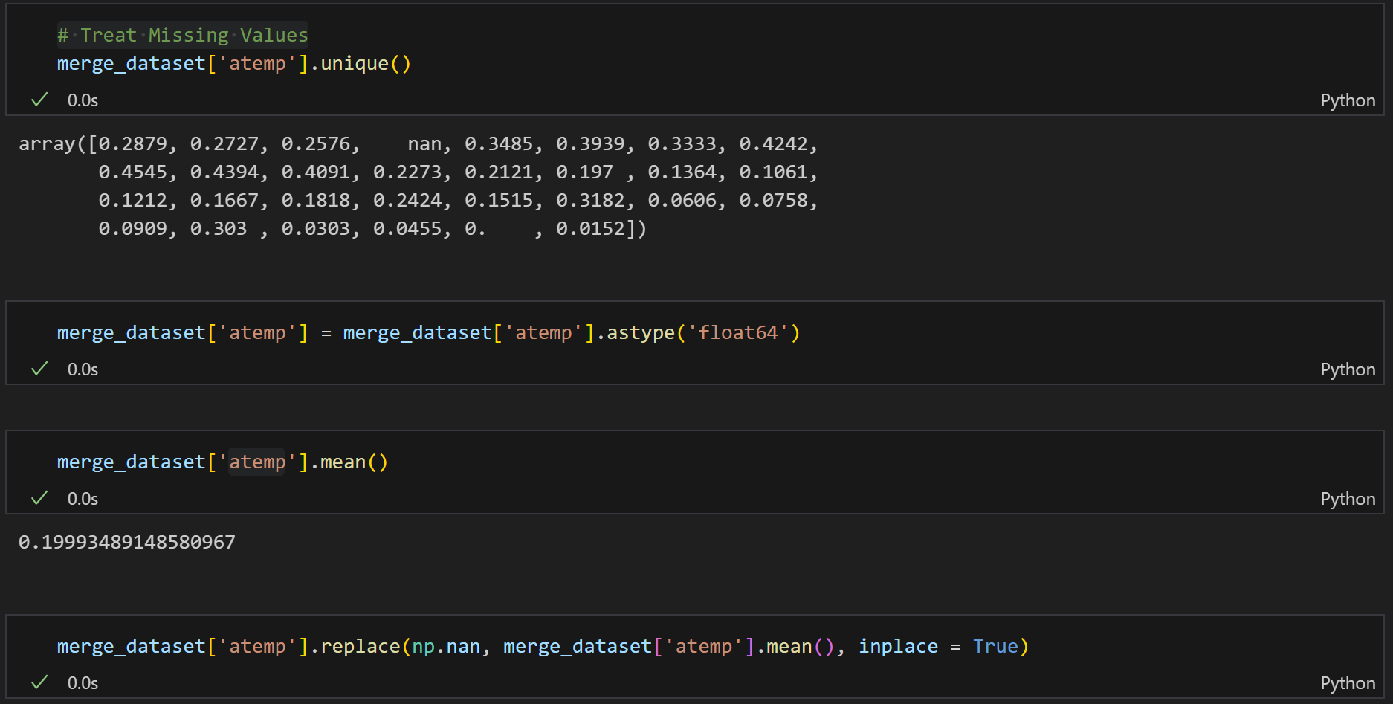
Identifying & Treating Missing Values

Slide 7
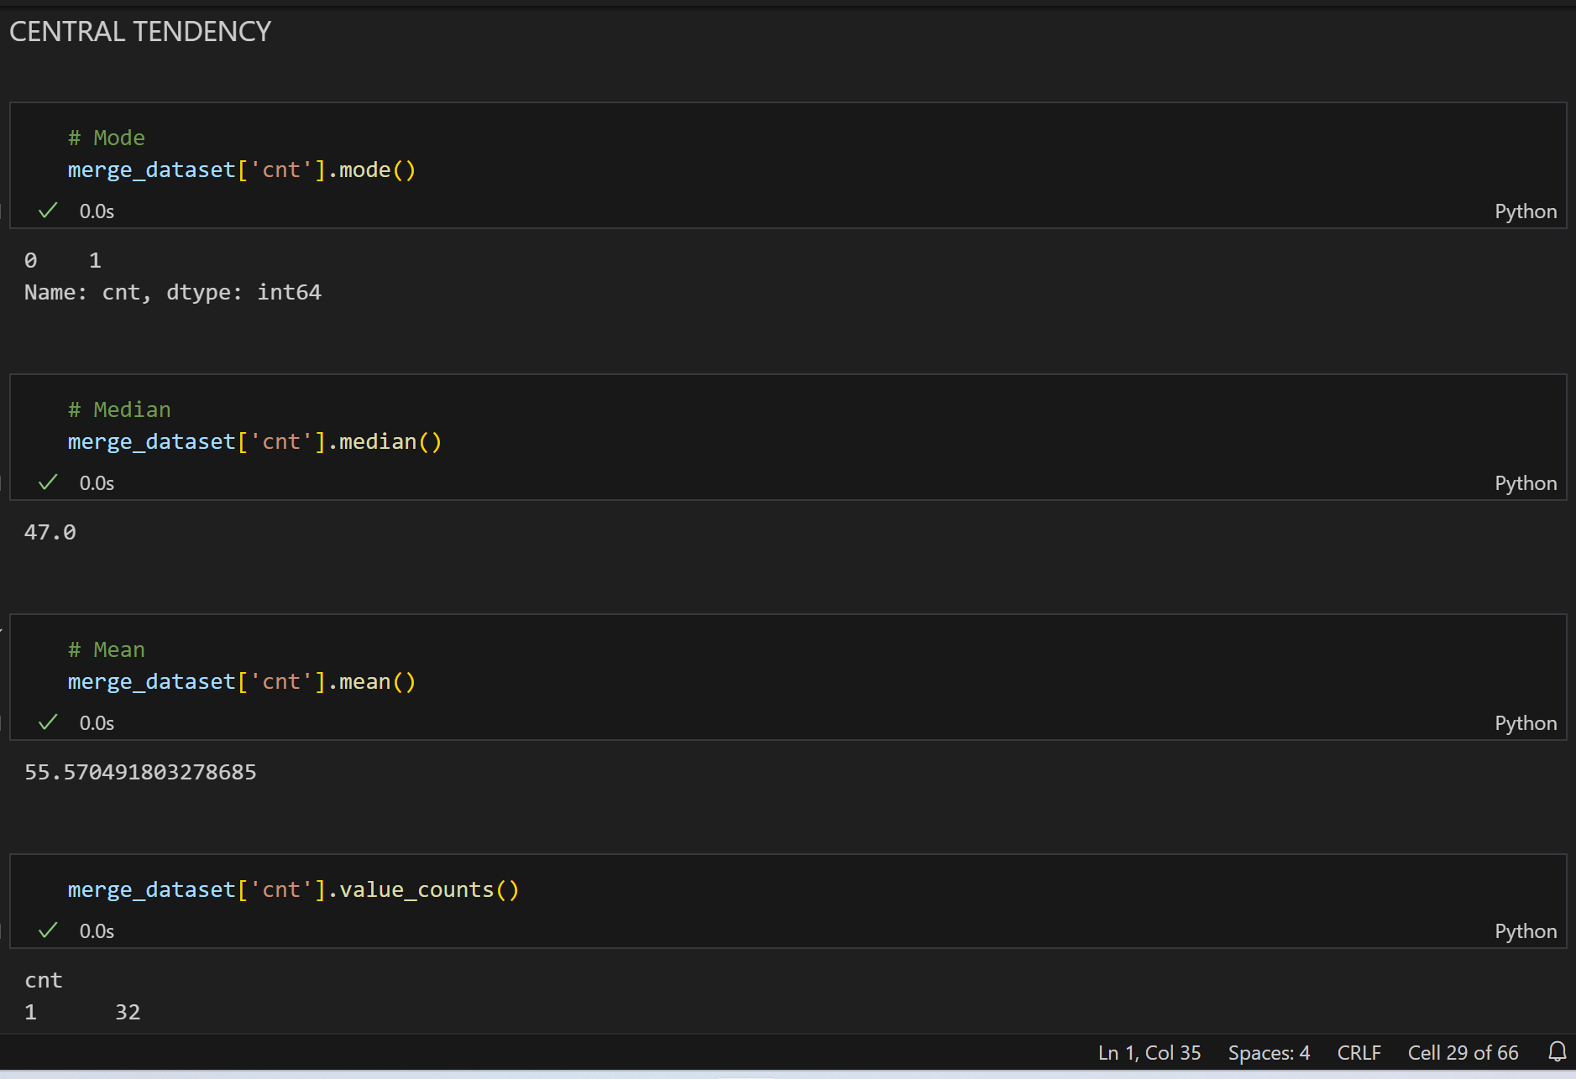
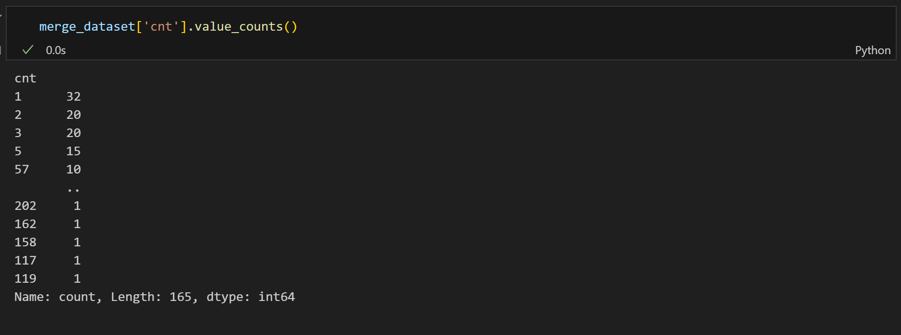
Central Tendency

Slide 8
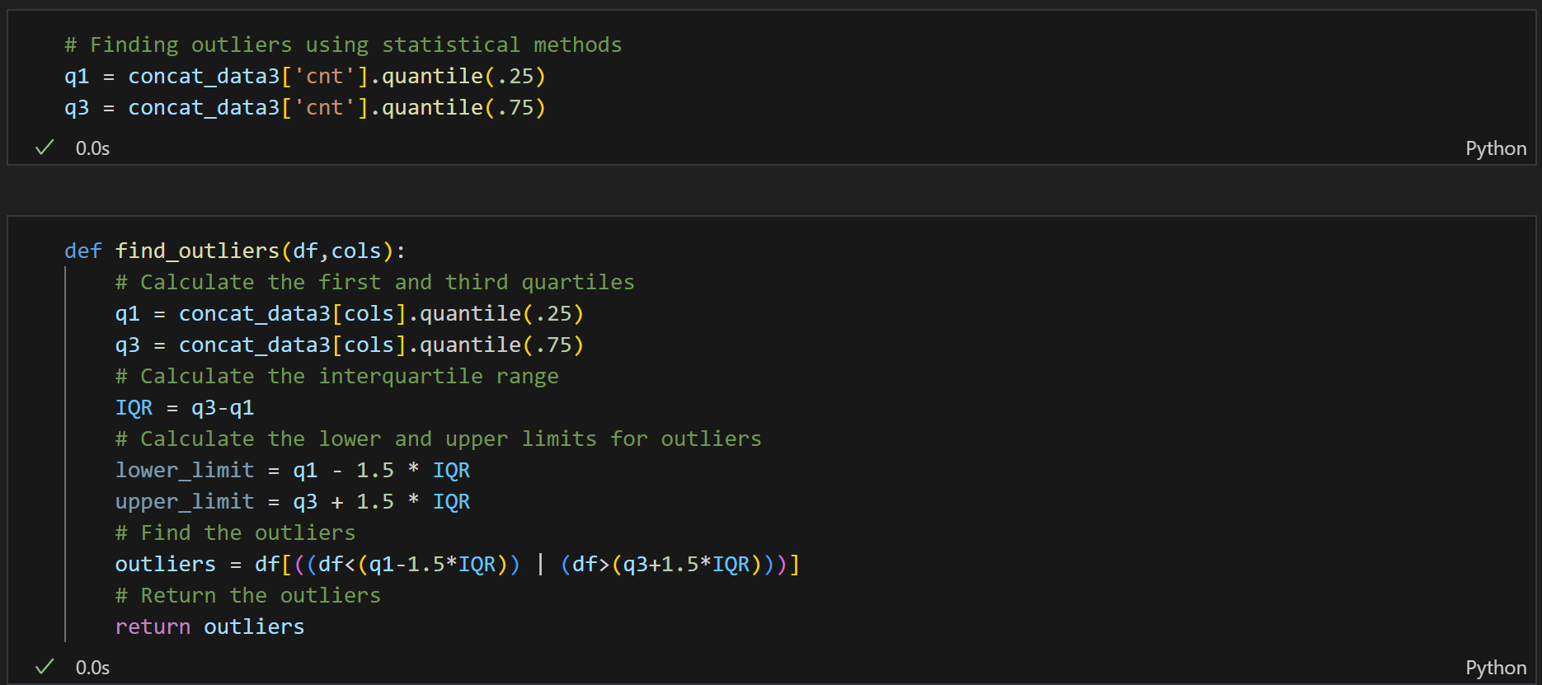
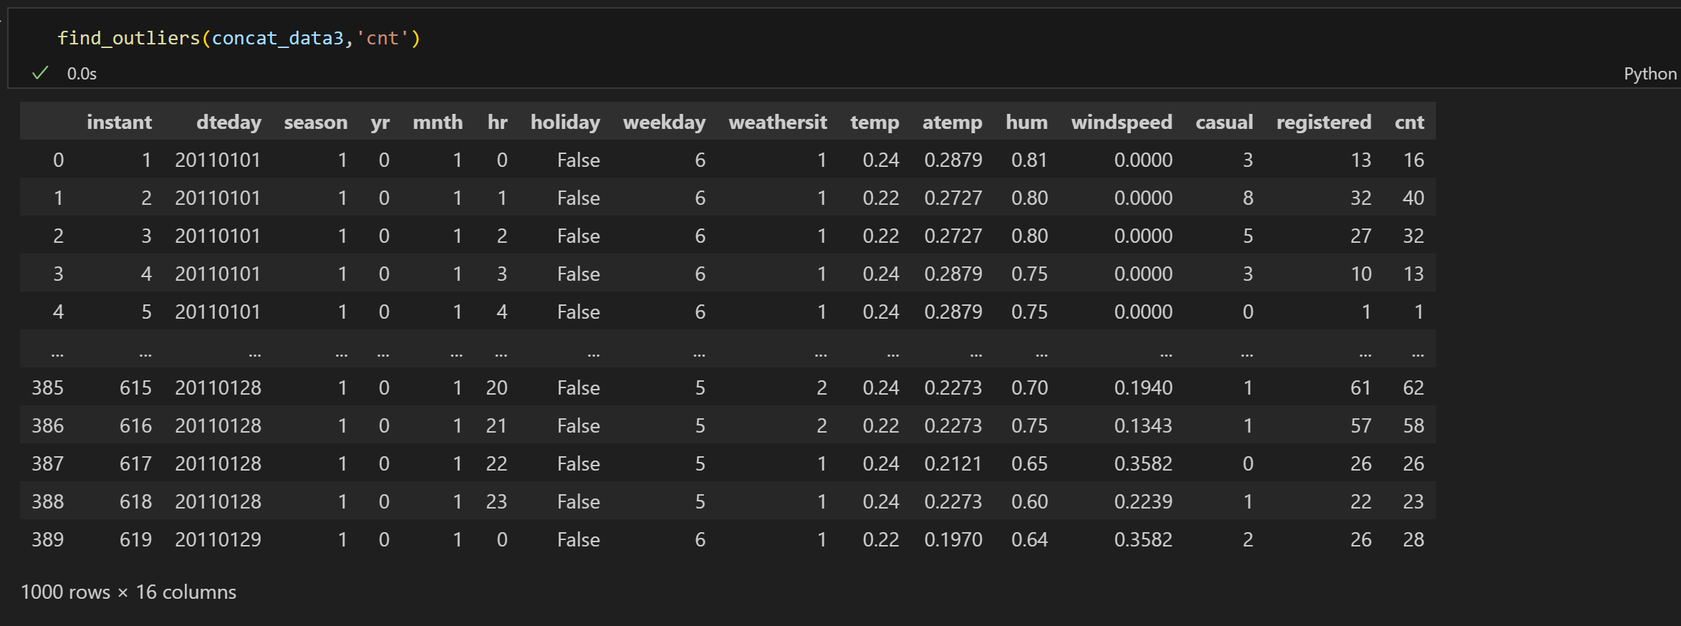
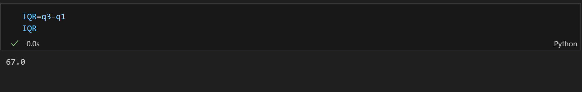
Finding outliers using statistical method - Interquartile range method

Slide 9
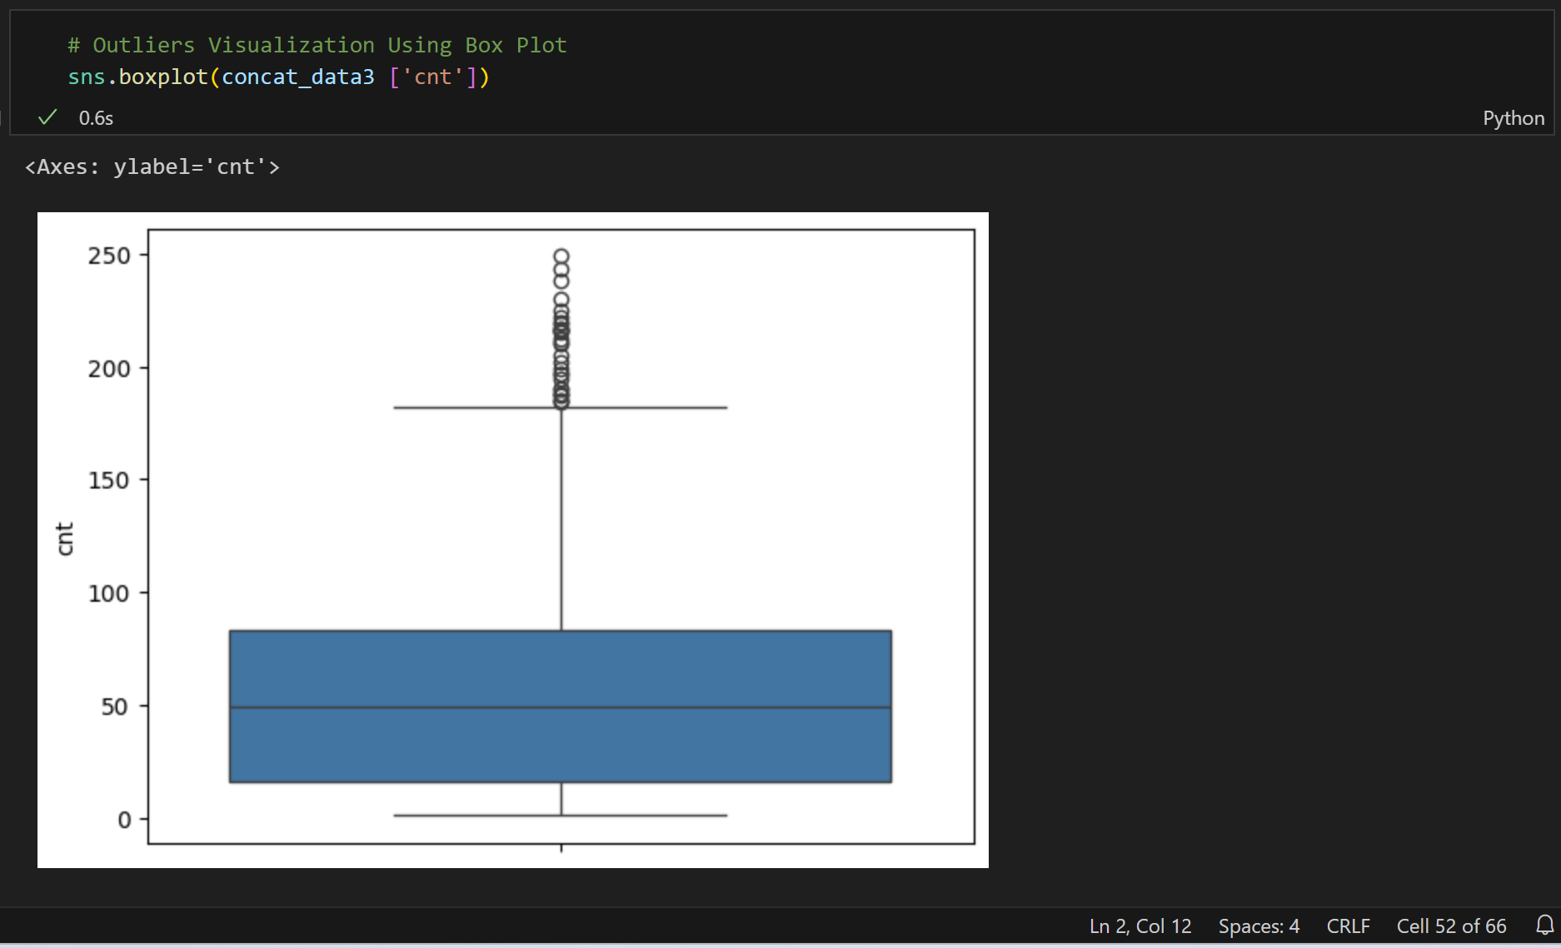
Outliers Visualization Using Box Plot

Slide 10
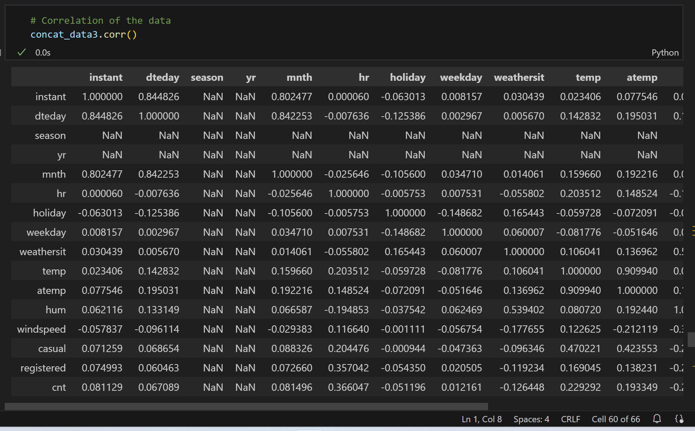
CORRELATION OF THE DATA

Slide 11
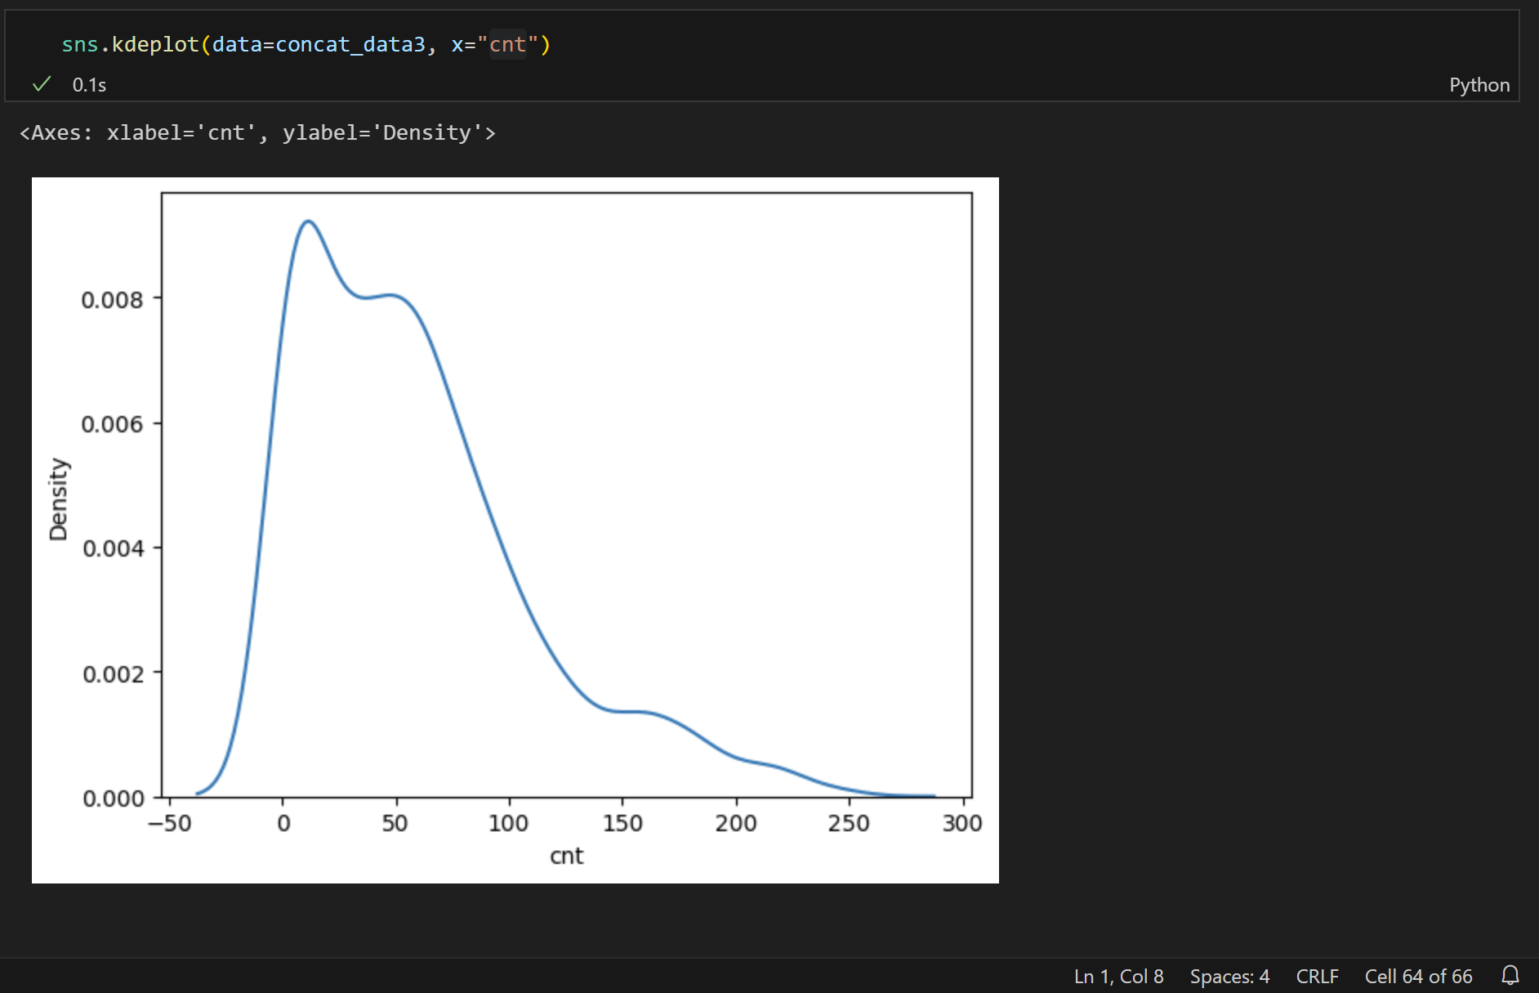
Skewness Plot univariate distribution
Cnt

Slide 12
THANK YOU

